Slide 1
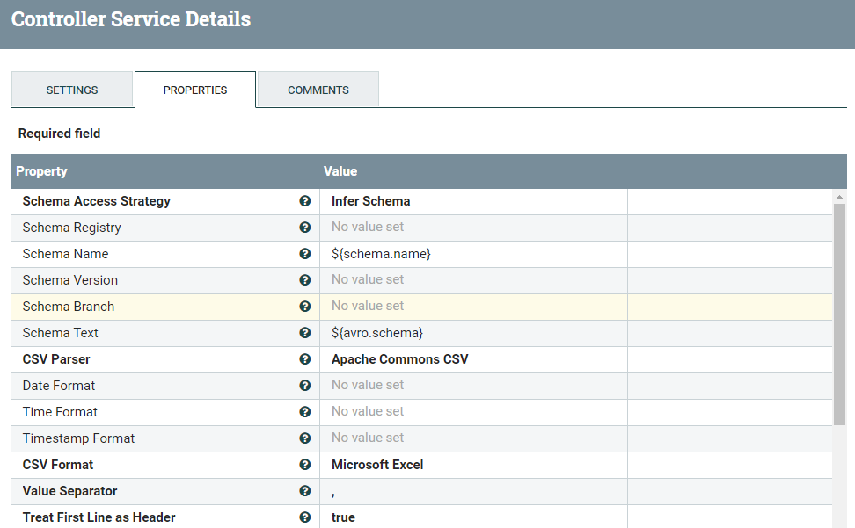

nifi controller
1. CSVReader

Slide 2
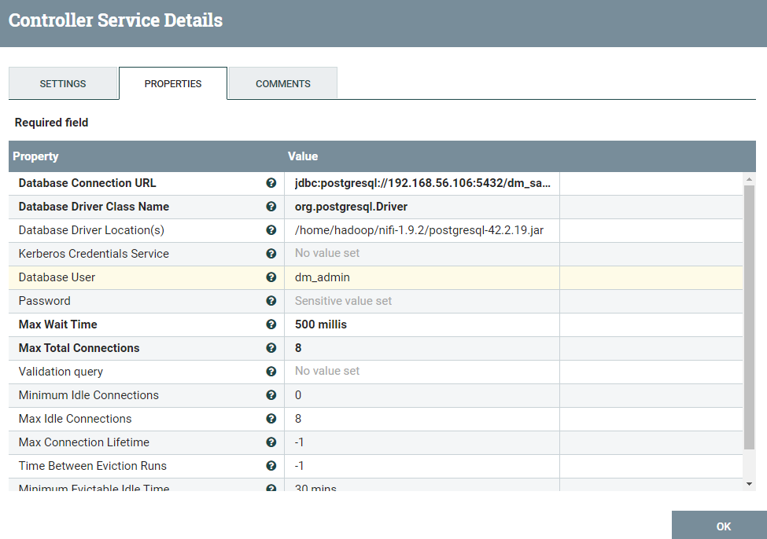
2. DBCPConnectionPool

Slide 3
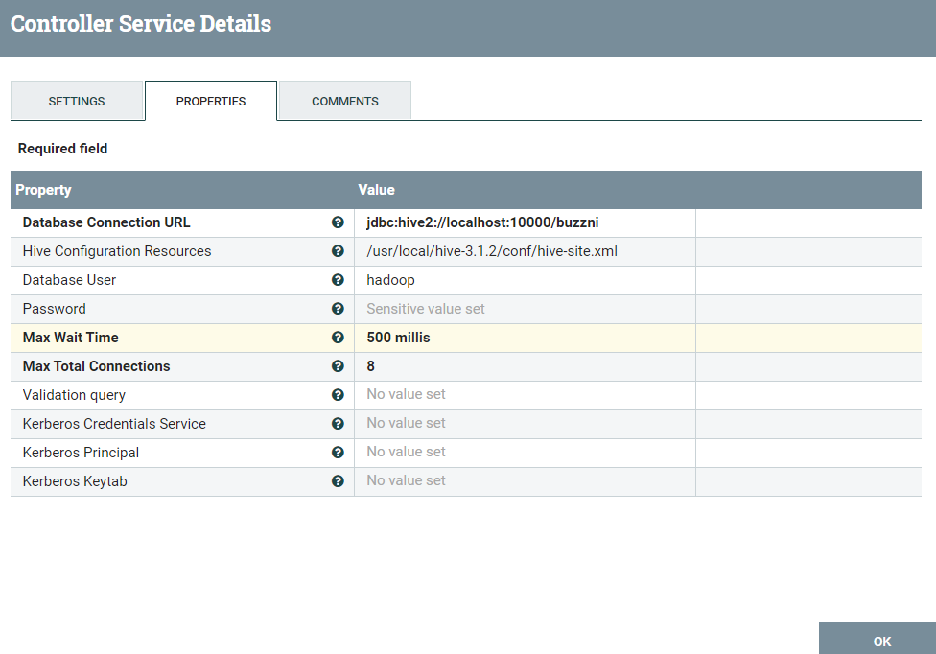
3. HiveConnectionPool

Slide 4
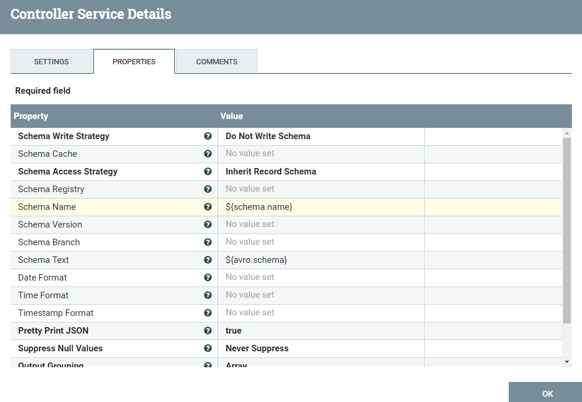
4. JsonRecordSetWriter

Slide 5
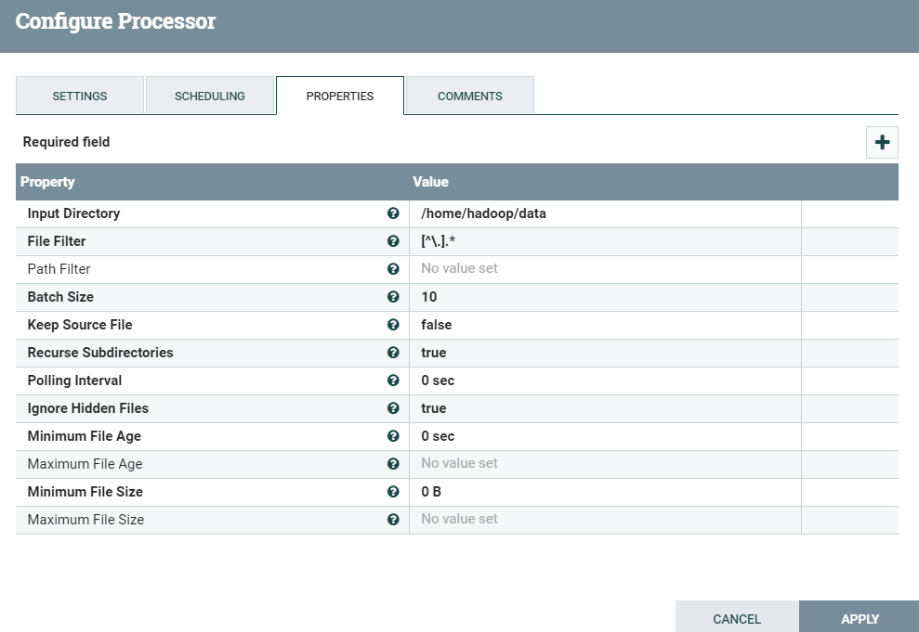
nifi processors
1. GetFile

Slide 6
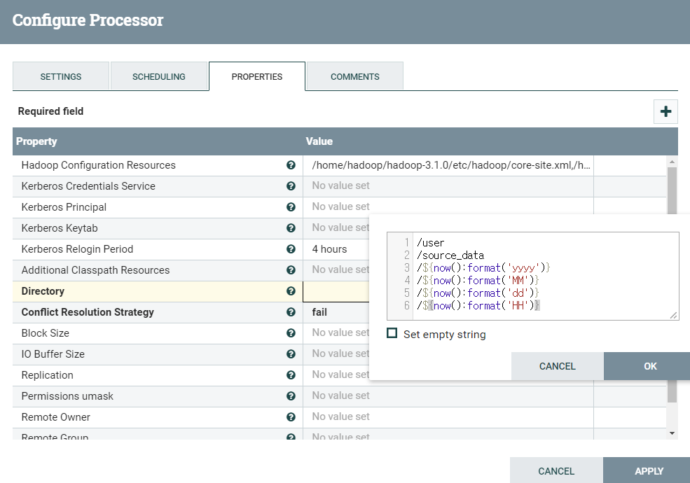
2. PutHDFS

Slide 7
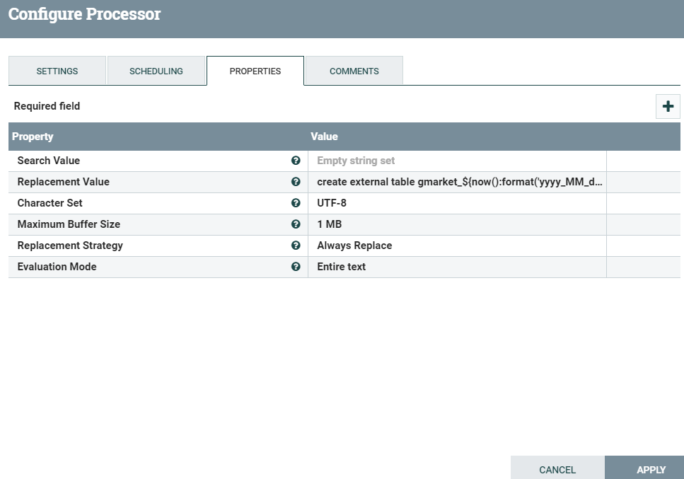
3. ReplaceText

Slide 8
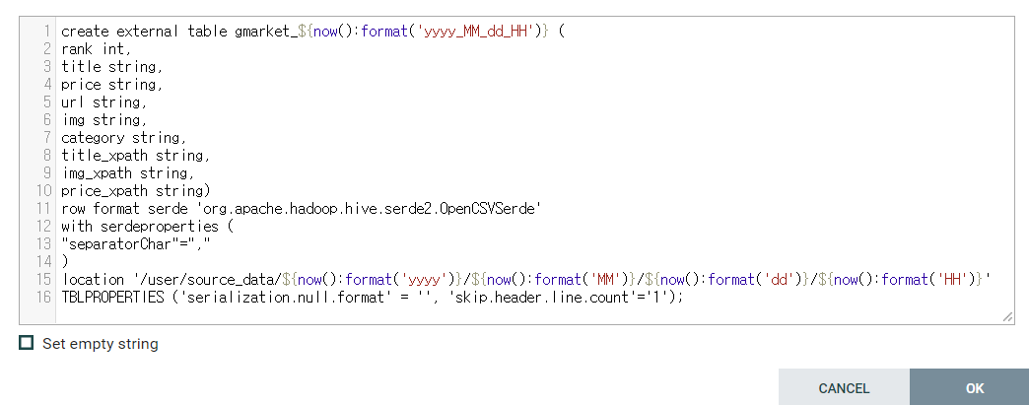

Slide 9
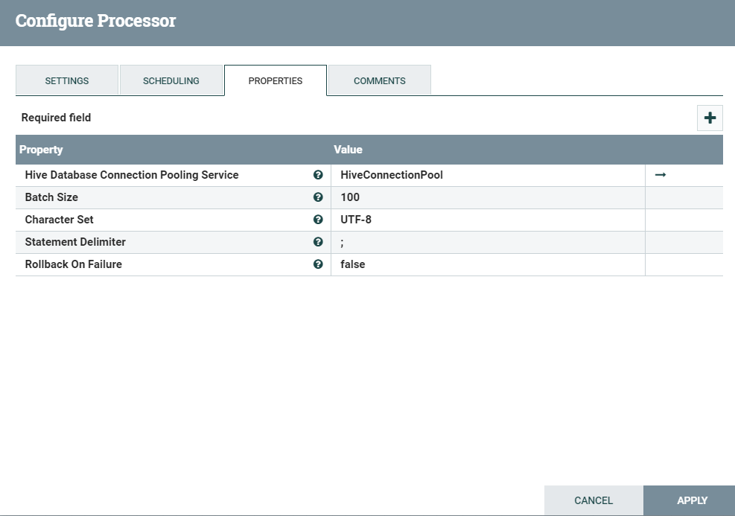
4. PutHiveQL

Slide 10
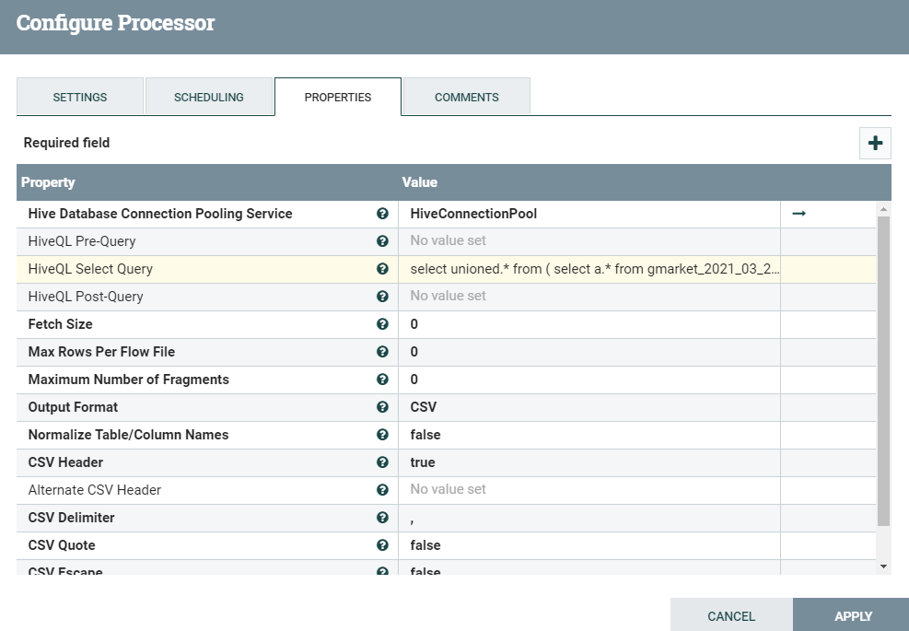
5. SelectHiveQL

Slide 11
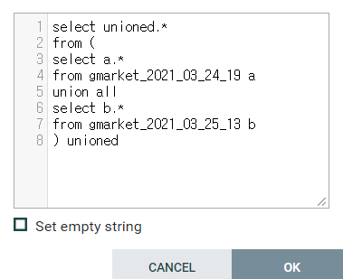

Slide 12
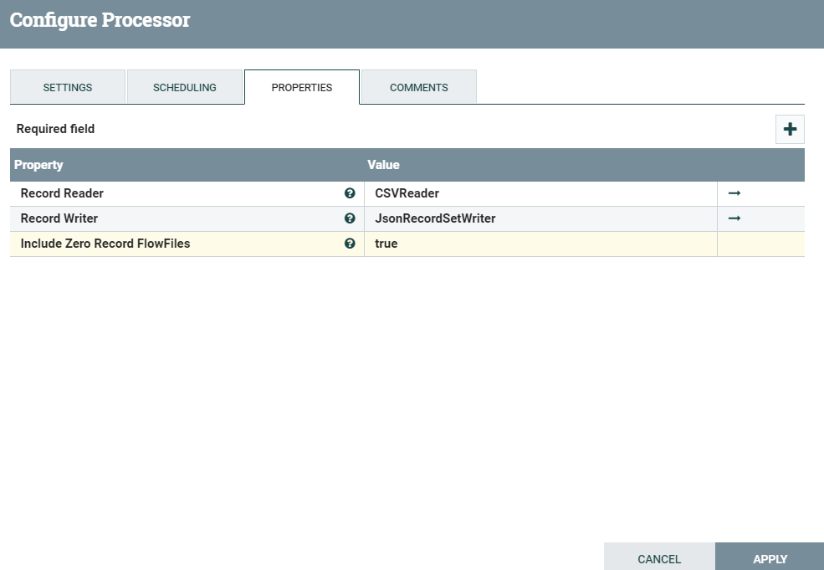
6. ConvertRecord

Slide 13
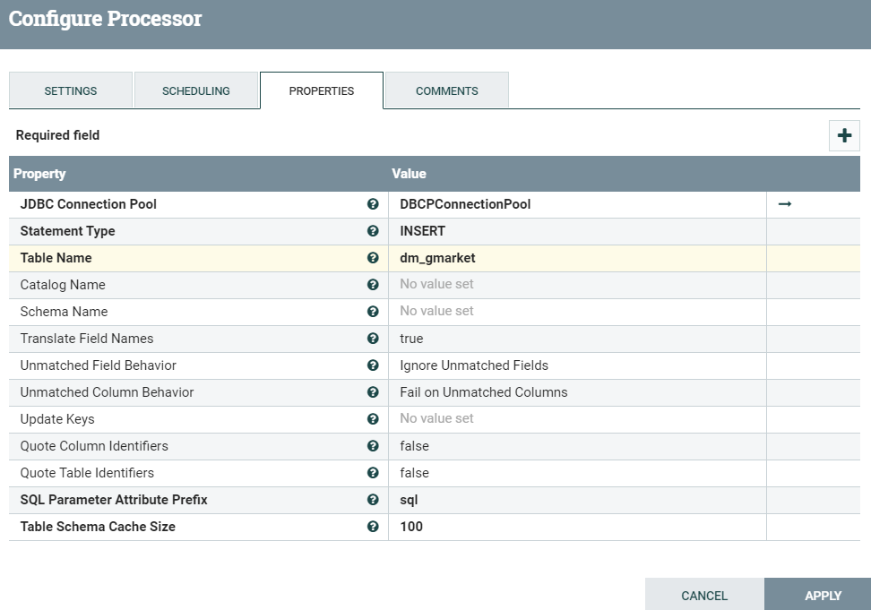
7. ConvertJSONToSQL

Slide 14
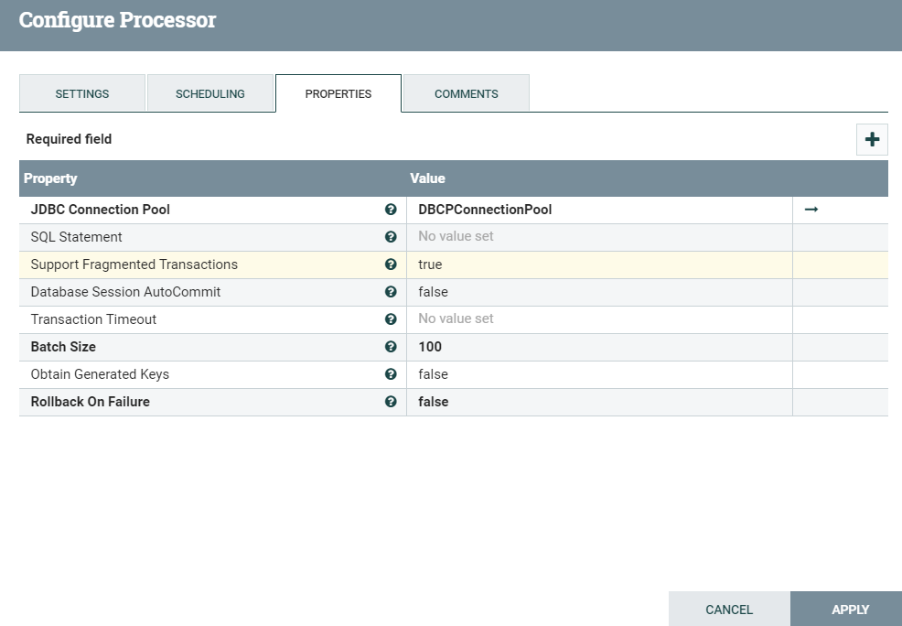
8. PutSQL

Slide 15
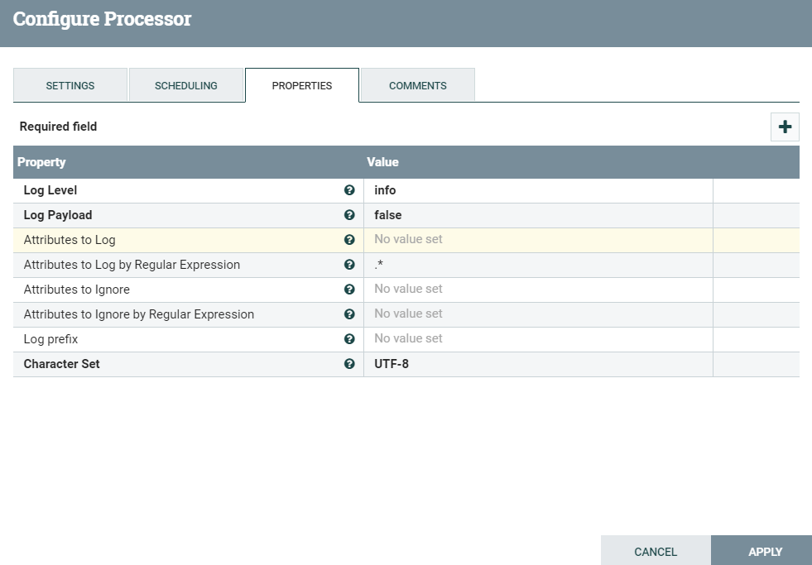
9. LogAttribute

Slide 16
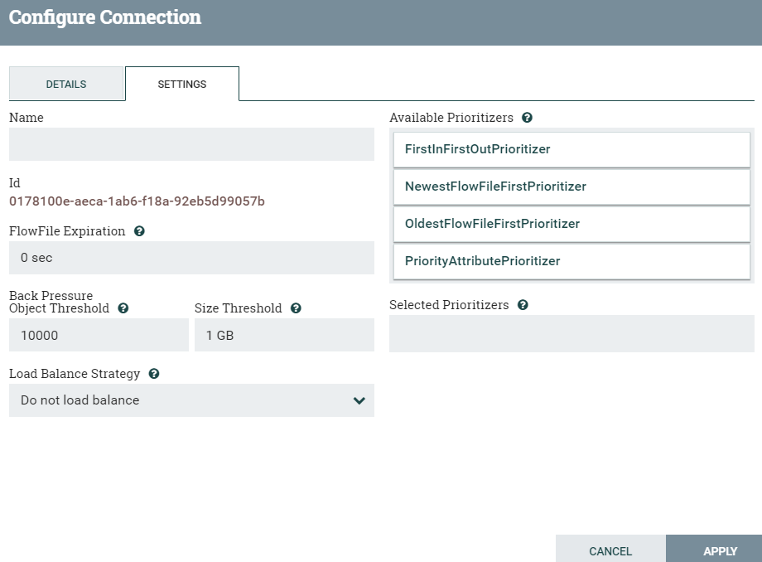
10. Queued

